Slide 1
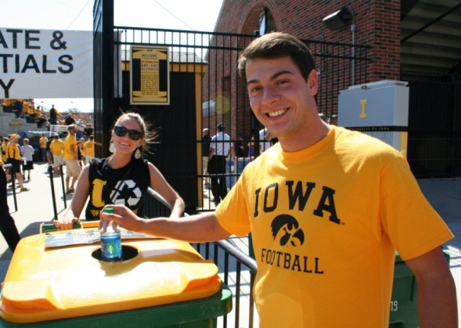
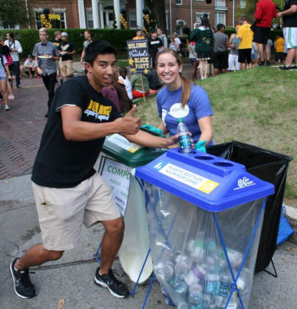
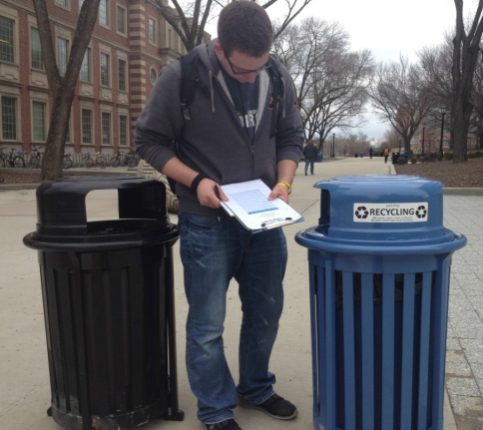
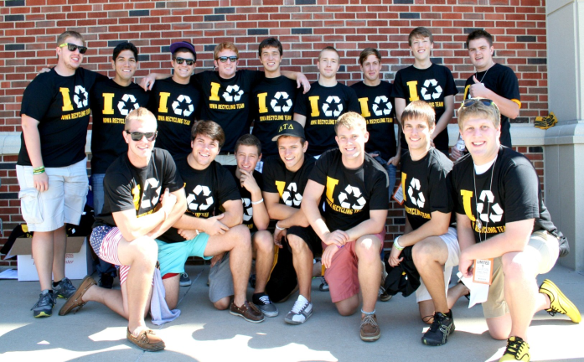
Growing Values
through
Waste Reduction
Notes:
Show some of the videos.
Review the agenda posted on the wall for today.

Slide 2
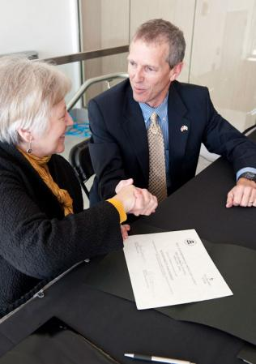
In it to win it
Commitment
Notes:
Signify commitment made by Sally Mason in 2010 as well as the ongoing commitments exemplified everyday on campus

Slide 3
The value adds up
Recycling is something that you can feel good about!
Environmental: Conserve energy and landscapes.
Economic: Why pay to throw away? We landfill $1.5 million worth of recyclable items each year. Recycling supports over 10,000 jobs in Iowa. Recycling 10,000 tons of plastic supports 93 jobs while landfilling that much supports 1.
UI Mission: Preparing citizens, leaders, and problem solvers of tomorrow
Recruitment: 69% of students consider sustainability as a factor
Health: Custodians can spend more time cleaning for health, which means a healthier environment for you and fewer injuries for them
Avoided costs: Fewer liners and fewer bins
Student Success: Opportunities abound (UISG, Delta Tau Delta, “Sustainable Systems” Class, ECO Hawk, UI Environmental Coalition, Associated Residence Halls)
Notes:
Many ways waste reduction adds value (not an attractive slide, currently)

Slide 4
What is valuable about waste reduction?
Waste reduction
Reduce
Reuse
Recycle
Reimagine
Landfill
Notes:
Define waste reduction

Slide 5
A culture of waste reduction: 2020
Physically: Look around you: It is clear that recycling and waste reduction is valued.
Socially: You hear conversations about recycling and waste reduction. You have them. People can identify opportunities and act on them. In your department, there is a local waste diversion expert, though everybody knows the basics.
This is culture or the perception of it is not limited to Facilities Management.
Can you think of another initiative on campus that holds this stature?
Notes:
This is how we will model our values on campus, physically and socially.

Slide 6
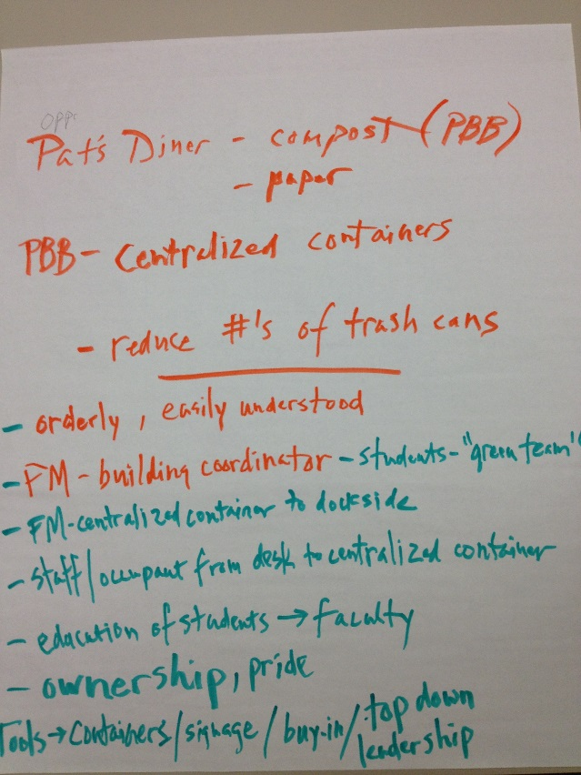
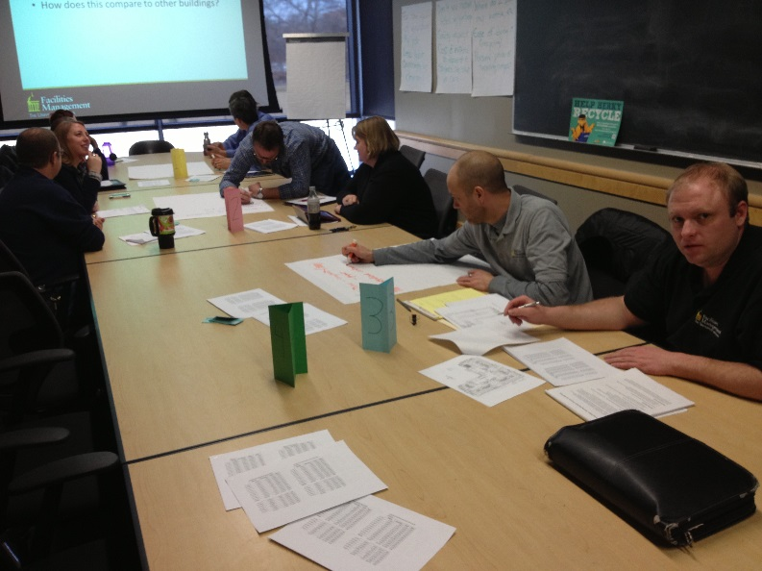
Recycling Optimization Projects
Enhance consistency, aesthetic, safety, and leanness
Begin with building walk-through
Public infrastructure
Classroom bins
Offices
Occupant roles

Slide 7
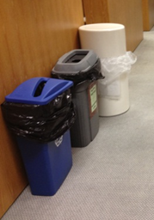
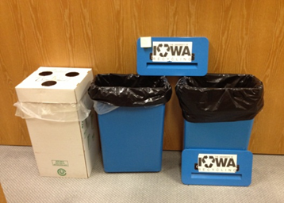
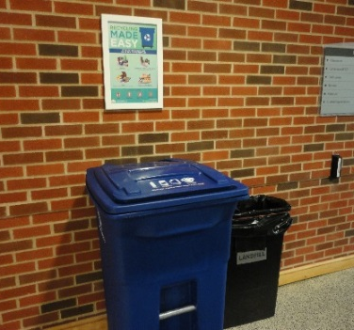
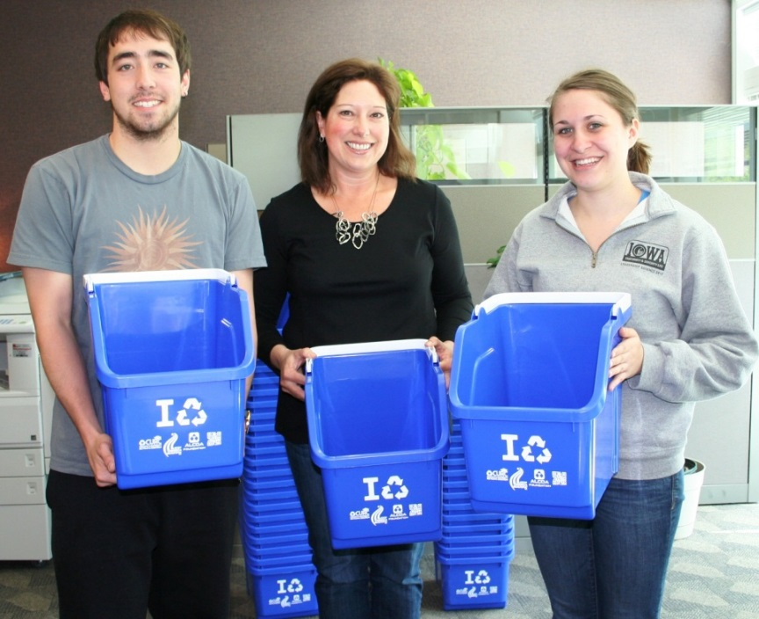
Optimizing infrastructure
Public setup
Roles
Before
After
Classrooms

Slide 8
Tiny Trash
Don’t forget about numbers

Slide 9
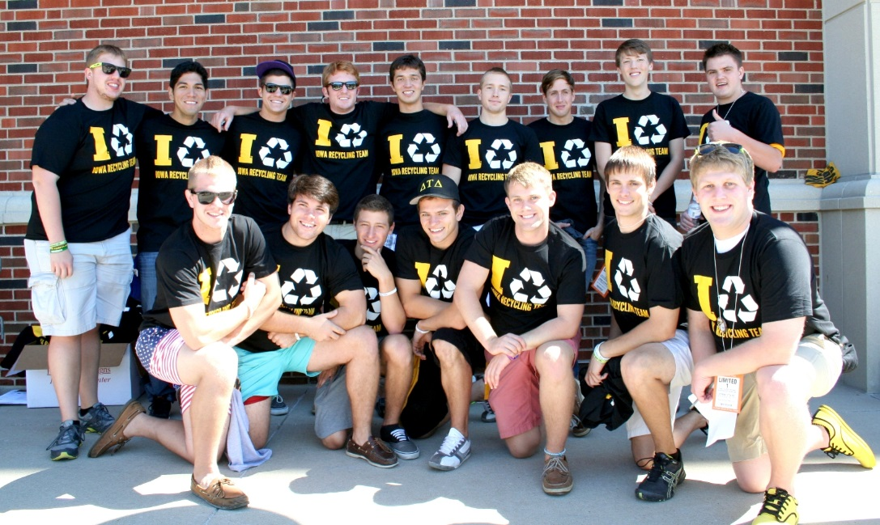
Social engagement
Orientation: Kickoff, Block Party, Grad students, RAs, International students
Events: Kinnick Stadium, Dance Marathon, America Recycles Day
Competition: RecycleMania
Waste audits: CPHB, Burge, Kinnick
Green Teams: Housing, DSB, PH
Presentations: On demand
Student leadership: Outdoor recycling
Newsletter: Quarterly

Slide 10
Data, what do we know?
FY13
Hospital
GEF
Housing
Athletics
IMU
Campus
BLS trash
932,660
3,436,945
1,584,130
186,264
279,290
6,419,289
Hawkeye
4,262,754
0
0
0
0
4,262,754
Stericycle
364,564
0
0
0
0
364,564
Single-stream
1,324,924
1,577,683
578,057
65,843
81,768
3,628,275
Shredding
263,117
161,442
705
0
1,359
426,623
Cooking oil
16,212
0
28,950
0
3,341
48,503
Gowns
3,565
10,100
0
0
0
13,665
Organics
39,620
0
229,970
21,816
30,000
321,406
Move-out
0
0
9,884
0
0
9,884
Surplus
250,000
555,432
250,000
0
0
1,055,432
Total Recycle
1,897,438
2,317,029
1,097,566
87,659
116,468
5,503,788
Total
7,457,416
5,753,974
2,681,696
273,923
395,758
16,550,395
Diversion
0.25
0.40
0.41
0.32
0.29
0.33
Snapshot, 2 years before and 2 years after single-stream
GEF: Waste up 21%, recycling down up 43%
Housing: Waste down 14%, recycling up 70%
Hospital: Waste down 13%, recycling up 43%
What does this not include?
Landscape Services
Hazardous and radioactive waste
Motor oil, tires, buses
Batteries
Construction and demolition waste

Slide 11
Leaders
Total Weight Leaders | Weight (lbs) | Diversion Rate (%)
Burge | 511,117 | 46
Hawkeye Court | 405,090 | 9
Medical Education Building | 395,456 | 35
IMU | 361,058 | 26
Hillcrest | 331,978 | 57
Dentistry | 296,120 | 27
Bowen Sciences | 274,064 | 29
Diversion Leaders | Diversion Rate (%) | Diversion Activities
Mossman Business Services | 79 | Single-stream (houses UI Printing)
University Services Building | 64 | Single-stream, shredding
Lindquist Center | 58 | Single-stream, shredding
Hillcrest Residence Hall | 57 | Single-stream, composting
Clinton Street Building | 51 | Single-stream, minimal shredding
Calvin Hall | 55 | Single-stream, shredding
Boyd Law Building | 50 | Single-stream, minimal shredding
Burge Residence Hall | 46 | Single-stream, composting

Slide 12
Emerging data
Landscape Services
Hazardous and radioactive waste
Motor oil, tires, buses, batteries
Construction and demolition waste
60%
Project potential
Tiny Trash Project
Composting
Glass, plastic bags, and labs
Contract requirements
Campus vendors
C&D contractors
Average waste audit
33%

Slide 13
Scenarios

Slide 14
Opportunities
Strategies
Tiny Trash Projects (+ public and classroom)
Organics (Burge and public)
Hospital
Purchasing (catering, campus vendors, C&D contractors)
Comprehensive recycling options and data collection
Teams
Recycling and Waste Reduction Committee

Slide 15
recycle.uiowa.edu
Eric Holthaus, Recycling Coordinator, eric-holthaus@uiowa.edu
Dave Jackson, Assistant to Associate VP, dave-jackson@uiowa.edu

