Slide 1
Campus Trash Audit
By: Yusef Abuissa, Delaney Albrecht, Jordan Barnett, Cole Billings, and Sydney Bortscheller

Slide 2
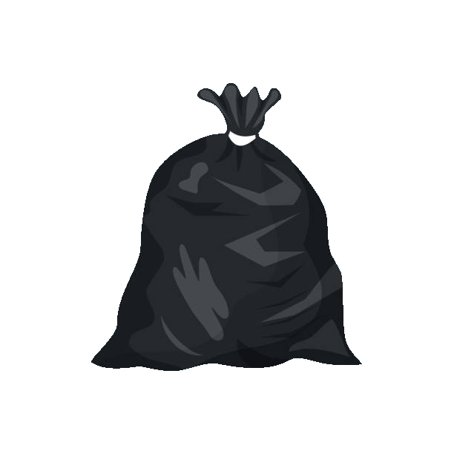
Methodologies
We traveled to three locations and asked for a bag each of recycling and trash to be set aside after collection
We then weighed the misplaced materials in each bag
44.8lbs
2.9lbs

Slide 3
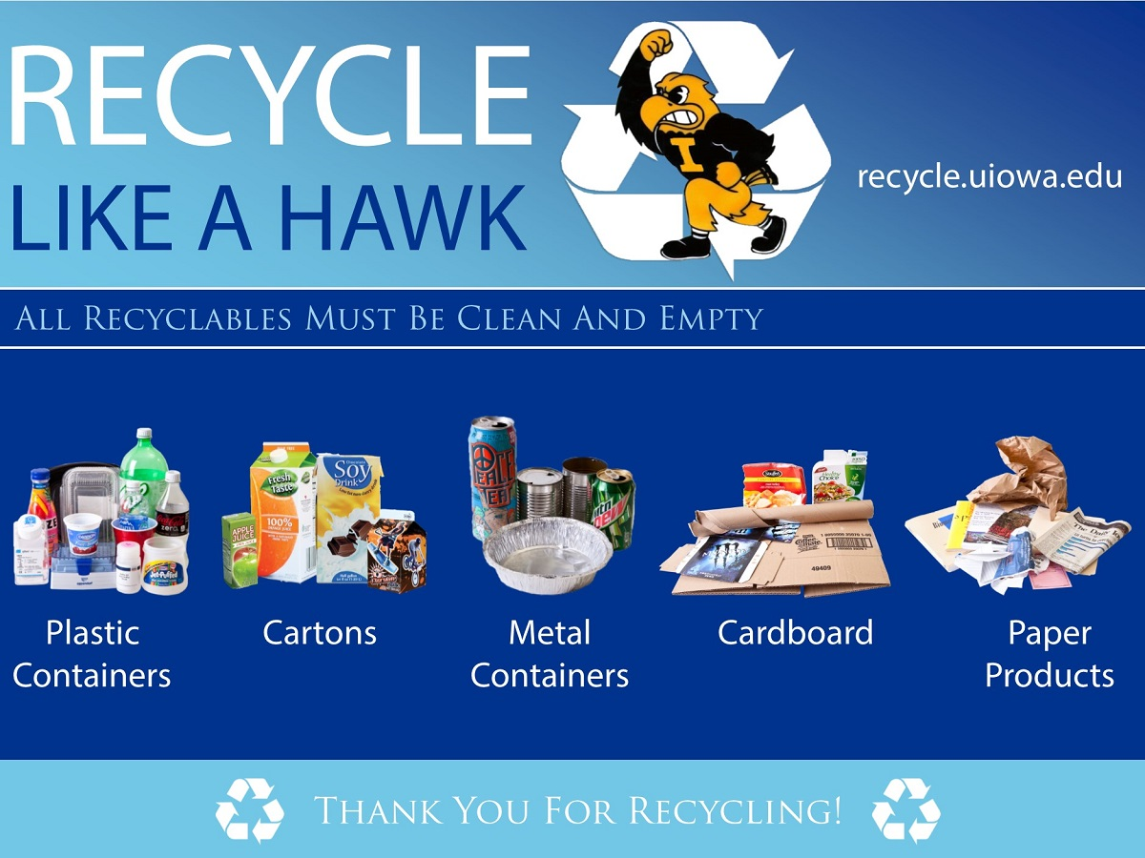
Motivation
Since there are so many students on campus using the trash, changing trash habits here can have a big impact
Misplaced trash is a big deal
Really simple and easy to correct our mistakes
It's apparent people don't properly recycle

Slide 4
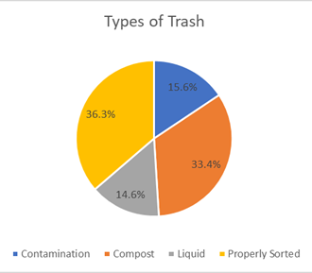
Findings
In our audit, we sorted through 44.6 pounds of designated garbage and 26.0 pounds of designated recycling.
We removing and weighed anything that didn’t belong and calculated the % that was misplaced.
In the end
6.5% of the material in the trash by weight was recyclable
30.4% of the material in the recycling bins was actually trash.
There was a lot of compostable material, but compost is very easily contaminated so compost collection would be tricky.

Slide 5
Online Pamphlet For more details

