Slide 1
Recycling Education in Schools
Sustainability Service Project
Harper Truog, Ethan Traugh, Alice Vervaecke, Rachael Wagner

Slide 2
Sustainability Education
In today's school system it is not mandated by Iowa Core to teach sustainability to students
It is left up to the teacher to decide whether they personally find the topic of sustainability to be important enough to be included in their lesson plans
This creates a wide gap of sustainability education
This Photo by Unknown author is licensed under CC BY-SA-NC.

Slide 3
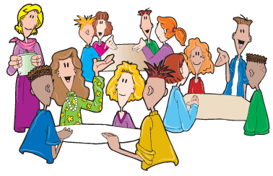
What did we do?
Went into Arthuer Elementary in Cedar Rapids to teach children how to properly recycle and why it is important to recycle
Through an interactive game and powerpoint we were able to teach students and see how much information they understood during our presentation
The group of third through fifth graders were excited to learn and share their own experiences with us
This Photo by Unknown author is licensed under CC BY-SA-NC.

Slide 4
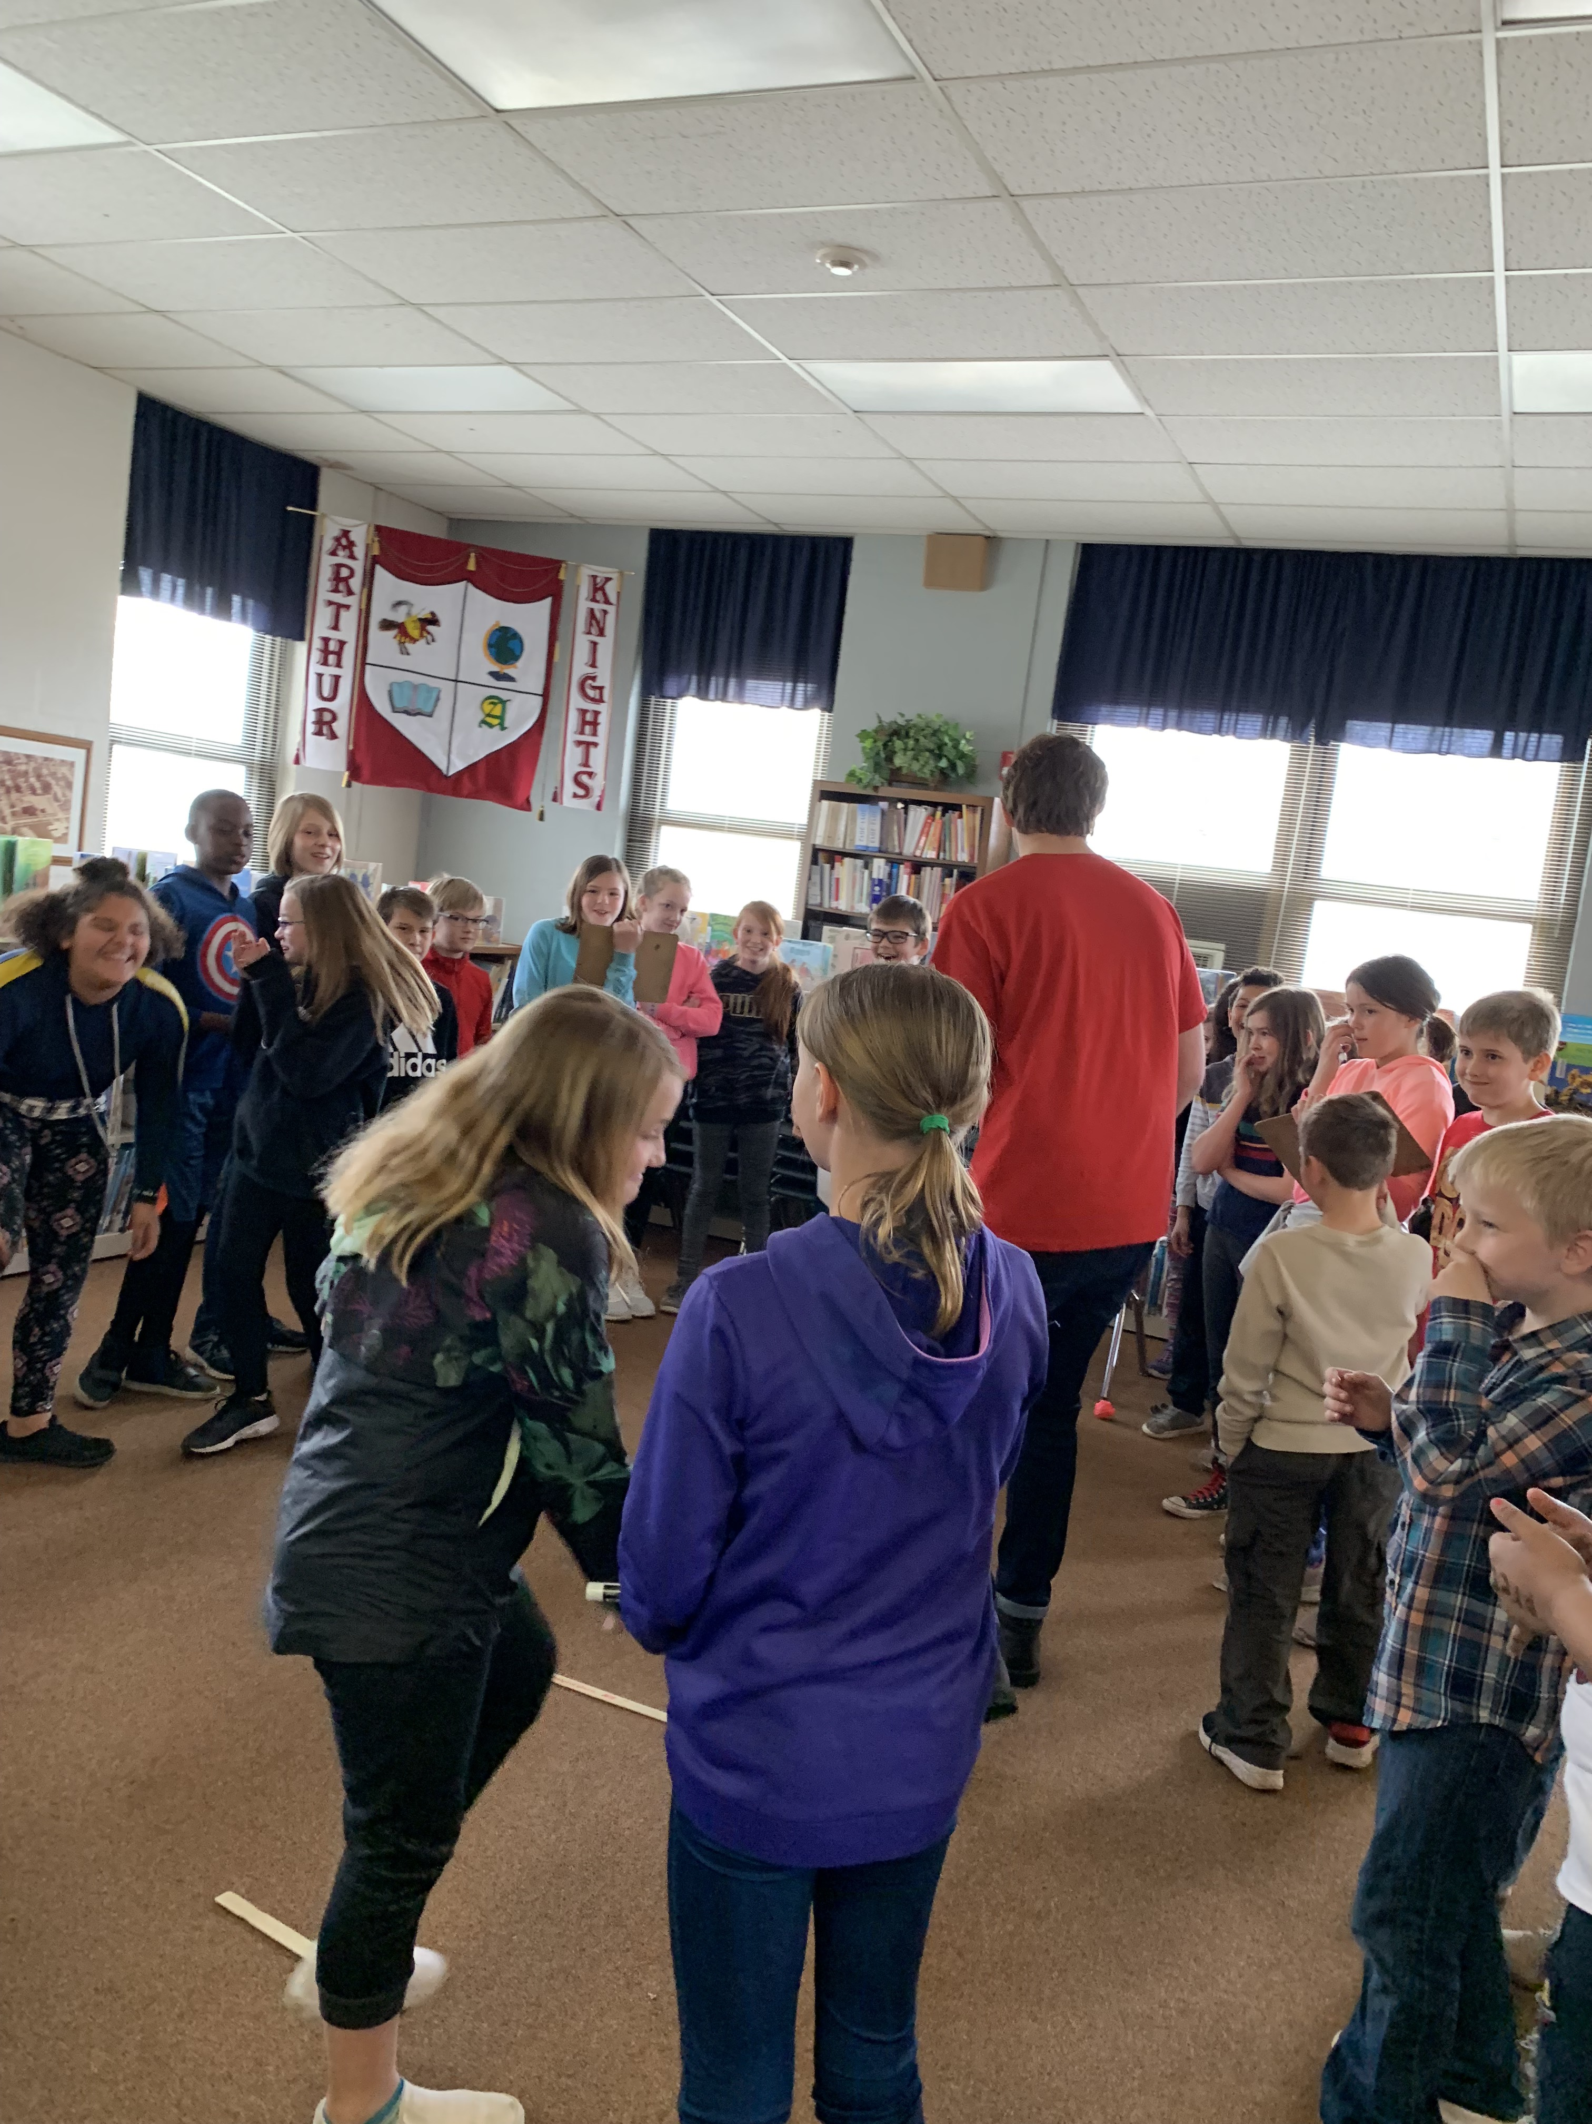
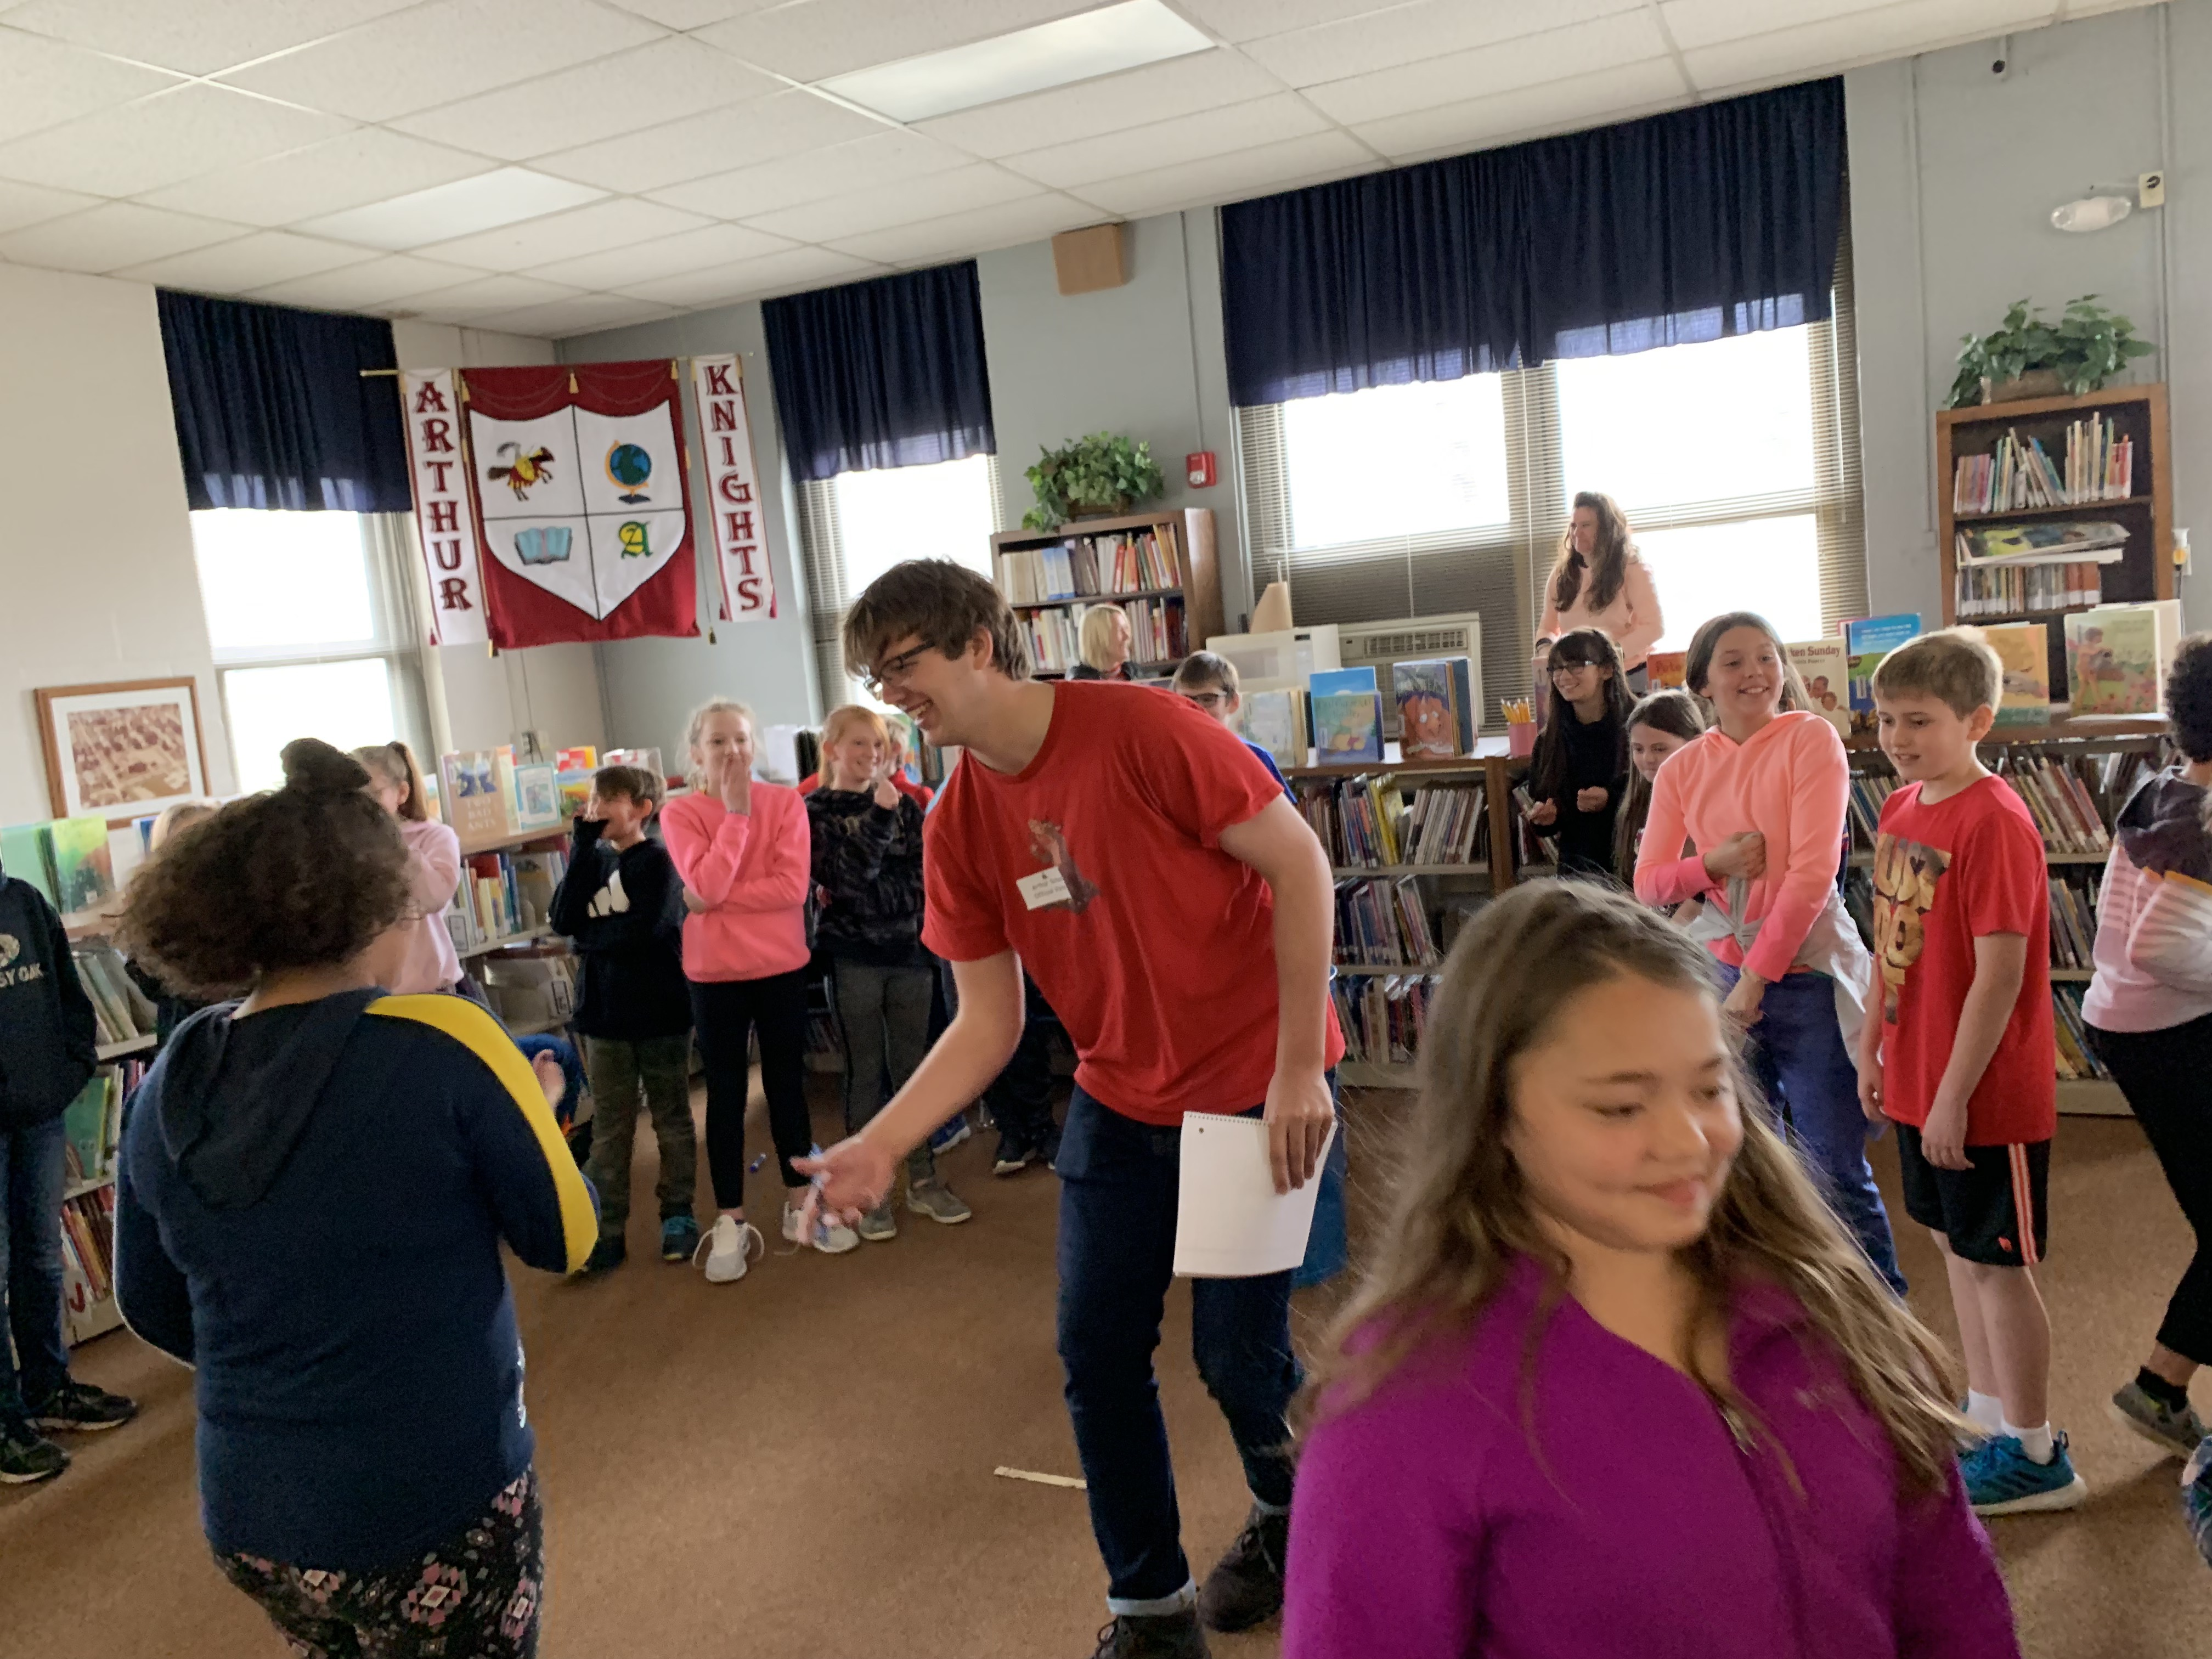
Outcomes
Comparing our pre-lesson verse post-lesson quiz on recycling scores the students increased from a 78% to a 97%
We found it very interesting to see how much students already know without formal education
Seeing how excited the students were to apply their own personal experiences shows how much they do care about this topic and how they would apply class lessons on sustainability to their lives

Slide 5
Our Goal
Not only trying to simply reduce the amount of trash that is entering our landfill, but also spark the younger generation to think about the problems that are occurring in our environment and ways to solve those problems
If our school system continues to lack sustainability education it could inhibit the ability of the next generation to create new solutions
This Photo by Unknown author is licensed under CC BY-SA-NC.

Slide 6
What needs to happen?
The Iowa Legislature needs to mandate through the Iowa Code that sustainability lessons need to be taught in conjunction with environmental classes in order to allow students to be exposed to these important topics at a younger age
Classroom lessons would close the gap between how teachers incorporate this topic into their classroom
This Photo by Unknown author is licensed under CC BY-SA-NC.

