Slide 1
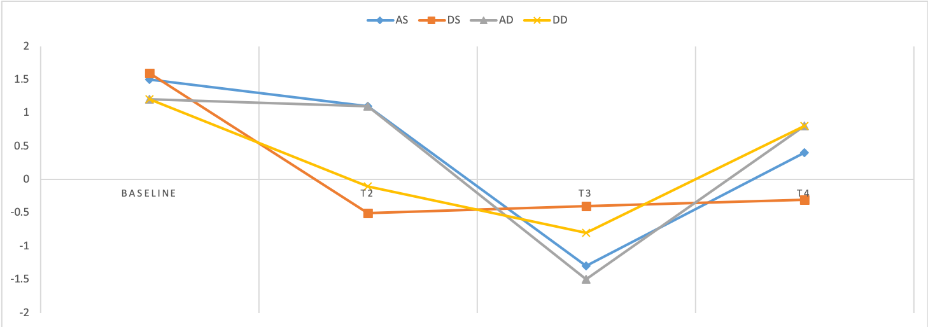
Examining Depression and Anxiety in Rural Advanced Cancer Patients
Receiving the Oncology Associated Symptoms and
Individualized Strategies (OASIS) Intervention
Isabella Penniston, BSN Student; Seyedehtanaz Saeidzadeh, MSN, RN; Stephanie Gilbertson-White PhD, ARNP-BC
Introduction
Methods
Results
Background
32-45% of cancer patients experience clinically significant depression or anxiety.¹
Depression and anxiety have been shown to effect psychological distress levels, body image and role identity, self-esteem, social support, and physical distress and dependency.²
Few studies have evaluated how internet-based interventions can alleviate the severity and distress of depression and anxiety in advanced cancer patients.
Description of the intervention
Oncology Associated Symptoms and Individualized Strategies (OASIS) is a web-based intervention created for rural advanced cancer patients to develop symptom self-management skills.³
Examining how the OASIS study impacts depression and anxiety may help improve the care of patients with advanced cancer with regard to psychological stressors.
Research Questions
What is the relationship between demographic characteristics and the severity and distress level of mood scores (anxiety and depression)?
How do mood scores change over time for participants who completed the intervention?
Recruitment and Eligibility
Patients were recruited in Ottumwa, IA, Bettendorf, IA, and Fairfield, IA via in-person recruitment by research assistants according to the following eligibility criteria:
Advanced cancer diagnosis
Age >18 years old
Living in small town or rural area
At least 1 distressing symptom
Have access to an Internet device with a video camera
Data collection & Analysis
Questionnaires were collected at four time points - baseline (T1), 4 weeks (T2), 8 weeks (T3), and 12 weeks (T4) - on which patients self-reported severity and distress of anxiety and depression.
Descriptive statistics were used to describe the sample. Quantitative analysis of the depression and anxiety scores that patients report was conducted.
Correlation was used to examine the relationship between demographic characteristics listed in Table 1 with the severity and distress of depression and anxiety in rural advanced cancer patients across all four time points.
Change scores for severity and distress of anxiety and depression were calculated by subtracting follow-up scores (T2, T3, T4) from baseline (T1) for participants who completed the entire intervention (n=14).
Significant associations between select demographics and anxiety and depression scores (n=13)
Note: AS=Anxiety severity, DS=Depression severity, AD=Anxiety distress, DD=Depression distress
Age: T1
Gender: T1
*Marital status: T1
DS | r = -0.71 | p =<.001
DD | r =-0.63 | p =0.01
AS | r = -0.76 | p = <.001
AD | r = -0.73 | p = 0.004
DS | F-stat =7.44 | p = 0.008
T3
DS | F-stat = 3.01 | p =0.09
DS | t = 3.77 | p =.0.02
*Marital status was the only demographic value with association outside of T1
Figure 1. Change in anxiety and depression scores for participants who completed entire intervention (n=13)
Note: AS=Anxiety severity, DS=Depression severity, AD=Anxiety distress, DD=Depression distress
Results
Age was significantly associated with mood scores (severity and distress) at baseline. Younger participants experienced higher levels of severity and distress in both anxiety and depression at baseline only.
Marital status was significantly associated with only depression severity at baseline and T3 with unmarried participants experiencing lower levels of depression severity and distress.
Gender had a significantly significant relationship with depression severity only at baseline. Male participants experienced lower levels of depression severity.
Change scores were most pronounced at T2 for depression scores and T3 for anxiety score. Depression severity remained low at T4 while depression distress and anxiety severity and distress rise but remained below baseline levels.
Table 1. Sample Demographics (n=13)
Age: Mean ± SD | 67.1 ± 11.0
Gender n (%)
Male | 7 (53.8)
Marital status: n (%)
Married | 12 (92.3)
All other | 1 (0.07)
Ethnicity: n (%)
White | 11 (91.6)
Non-White | 1 (8.3)
Rural code: n (%)
Rural area | 2 (15.4)
Small town community/high commuting | 4 (30.7)
Micropolitan/metropolitan area core | 7 (53.8)
Education status: n (%)
High school | 3 (23.08)
Some college/tech | 8 (61.5)
Employment status: n (%)
Employed | 10 (76.9)
Unemployed | 3 (23.08)
Income status: n (%)
< 60,000 | 9 (69.2)
≥ 60,000 | 4 (30.7)
Frequency of internet usage: n (%)
Multiple times per day | 7 (53.85)
All others | 6 (46.15)
Conclusion
The associations with demographic characteristics and mood are consistent with previous research,
The relationship between age and mood in the T1 survey indicates that the OASIS intervention maybe especially beneficially to younger patients.
Similarly, married and female patients had worse depression and anxiety and may especially benefit from OASIS.
Change scores indicate the depression scores respond faster than anxiety and that the intervention may need modification to sustain these effects overtime.
Future research is needed to test efficacy of the intervention through an RCT and determine if these demographic differences exist in a larger sample
References and Acknowledgments
1. Linden, W., Vodermaier, A., MacKenzie, R., Greig, D. (2012). Anxiety and depression after cancer diagnosis: Prevalence rates by cancer type, gender, and age. Journal of Affective Disorders, 141, 343-351. DOI:10.1016/jjad.2012.03.025
2. Kostopoulou, S., Parpa, E., Tsilika, E., Katsaragakis, S., Papazoglou, I., Zygogianni, A., Galanos, A., Mystakidou, K. (2018). Advanced cancer patient’s perceptions of dignity: The impact of psychologically distressing symptoms and preparatory grief. Journal of Palliative Care, 33(2), 88-94). DOI: 1.0.1177/0825859718759882
3. Gilbertson-White, S., Yeung, C.W., Saeidzaheh, S., Tykol, H., Vikas, P., Cannon, A. (2018). Engaging stakeholders in the development of an eHealth intervention for cancer symptom management for rural residents. The Journal of Rural Health, 0, 1-10. DOI: 10.1111/jrh.12297
Contact: Isabella-Penniston@uiowa.edu
Funding from:

