Slide 1
ACT: Active Conservation Training
A Guide to Sustainability Curriculum
By Connor Johnson, Jillian Shrader, Kristyna Bradley, Anna Nelson, and Libby Chelsvig

Slide 2
Energy
Lesson Plan
Understanding what energy is and how people use it
Energy usage and sources in everyday material things
Fossil fuels
Renewable energies
Solar
Wind
Hydropower

Slide 3
Agriculture
Lesson Plan:
Land degradation due to farming
Overgrazing
Deforestation
Desertification
Loss of Biodiversity
Corn Basics
Difference between field corn and sweet corn
Problems with growing field corn
Herbicides and Pesticides
Solutions

Slide 4
Waste
Lesson Plan: Waste Management
Ask: What is waste? Does Nature create waste?
Discuss product life and death – 3 R’s and how they interconnect with one another.
Encourage students to take discussion and recycling ideas from the classroom home.
Activity: Waste Sorting Game
Sorting waste into trash, recycling, and compost
What has to be thrown out
What can be repurposed to help make nutrient rich soil
What can be recycled
Plastic can take 1,000 years to degrade in a landfill, aluminum 500, ect

Slide 5
Animals and Ecosystems
Lesson Plan: Animals and Ecosystems
What are ecosystems and their services
What they provide
Why they’re important
Examples of animals that make ecosystems go round
Birds, bees, bats, ect
Activity: Nature Walk
20 minutes to a few hours
Explore local parks, green spaces
Education about local nature
Flora and fauna
Geography and geology
Public lands
Leave No Trace
Alternative forms of transportation

Slide 6
Consumption
Lesson Plan:
Role of consumption in sustainability efforts
Consumerism and impact an American society
Sustainable Consumption patterns
Activity: Make your own tote bag
Have students bring an old T-shirt, stained, too small, etc. Students will also need scissors, and can use markers or extra string as desired.
Make 4-8 inch vertical cuts from bottom, tie pieces together in knots to close bottom of bag or sew if preferred.
Cut sleeves and collar out to create straps
Decorate as wanted

Slide 7
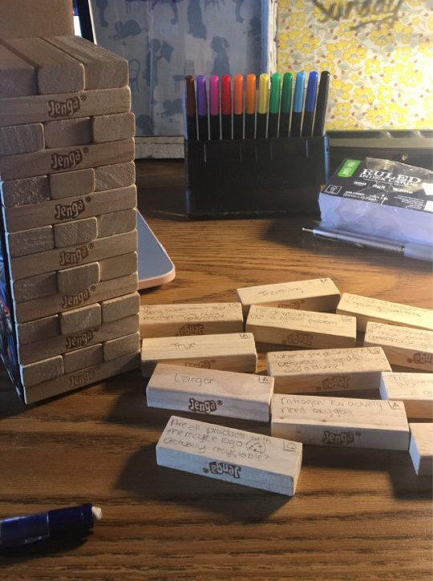
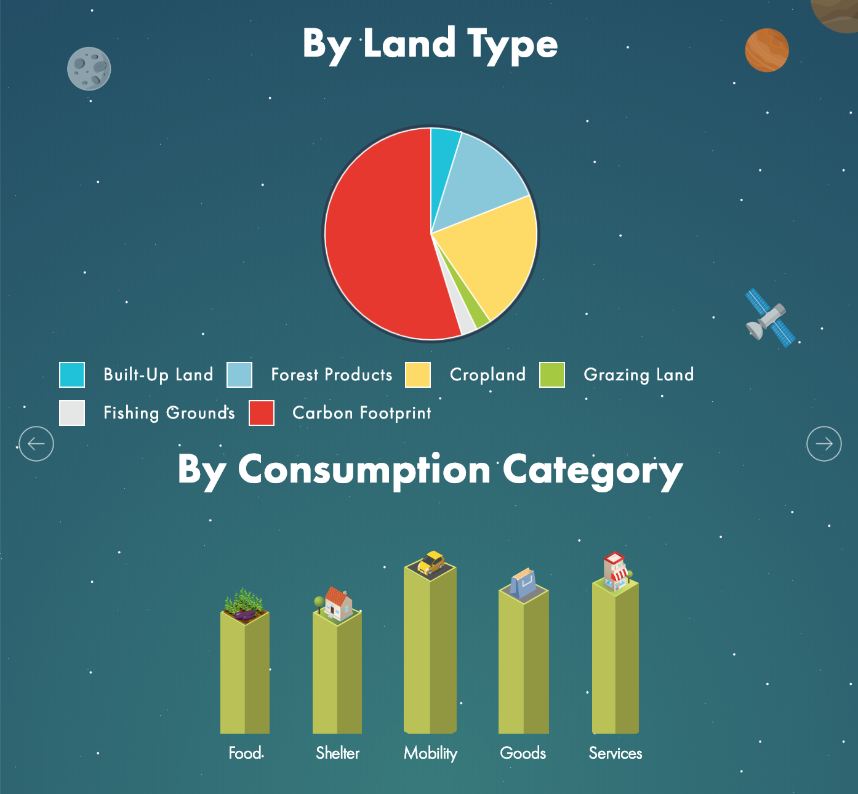
Other Activities
Trivia Jenga:
Ecological Footprint:
Estimate individual footprints
Compare and discuss results
Discuss methods to decrease their ecological footprints
Challenge to create lowest, realistic, footprint value
Encourage students to make changes in their lives to reflect their revised ecological footprints

