Slide 1
Overview of Campus Energy Systems October 9, 2013

Slide 2
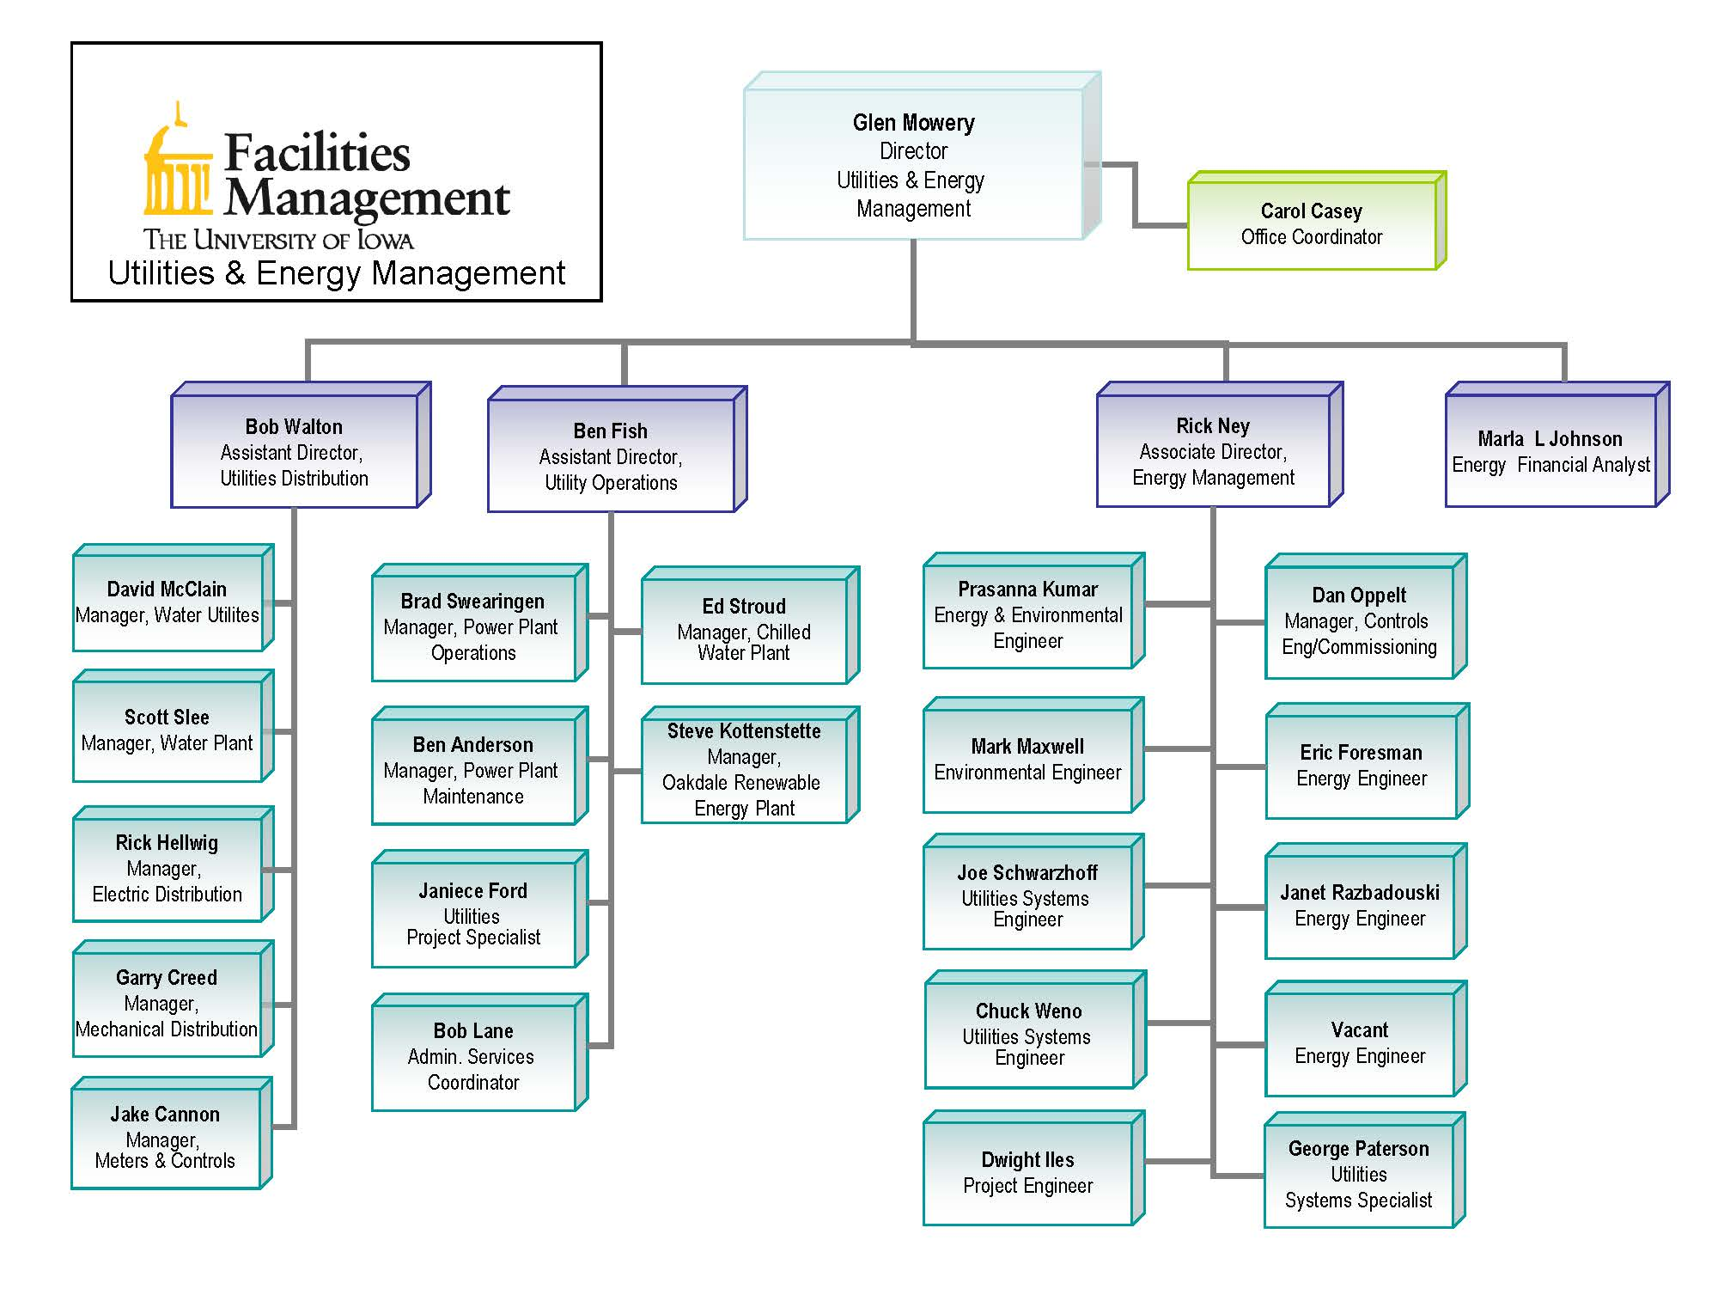
Utilities & Energy Management

Slide 3
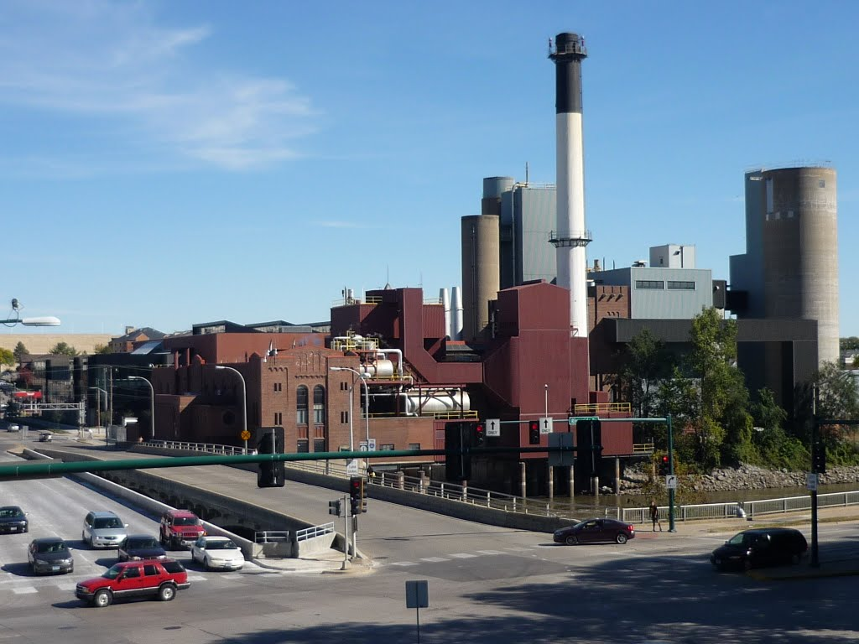
Supply Side

Slide 4
Energy Suppliers

Slide 5
Energy Suppliers

Slide 6
Energy Suppliers

Slide 7
Energy Suppliers

Slide 8
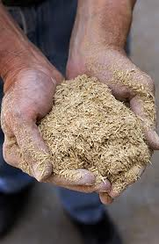
Energy Suppliers

Slide 9
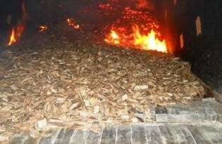
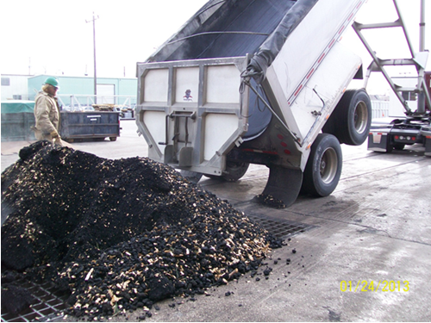
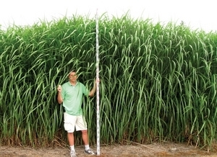
Other Renewable Fuels

Slide 10
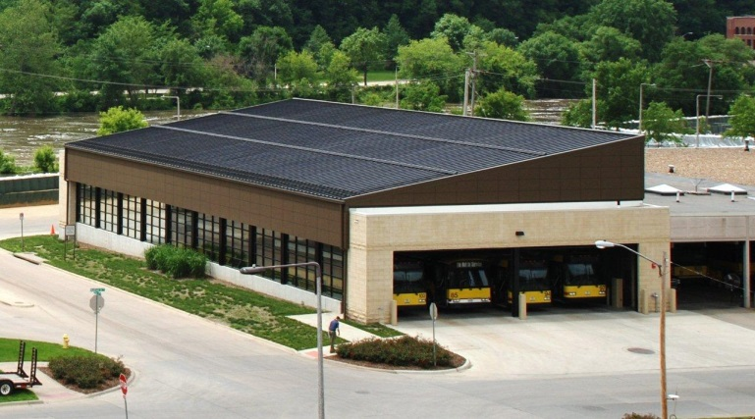
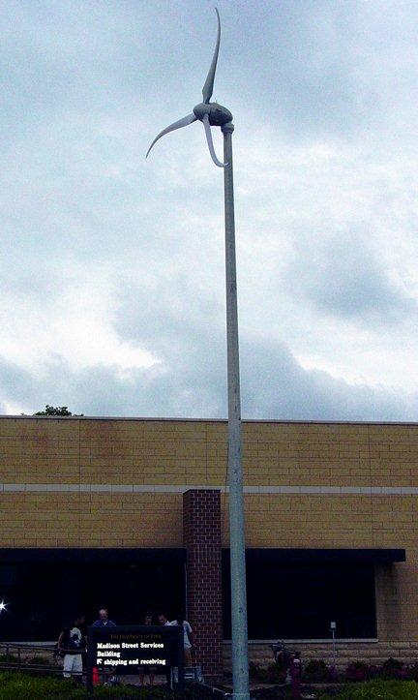
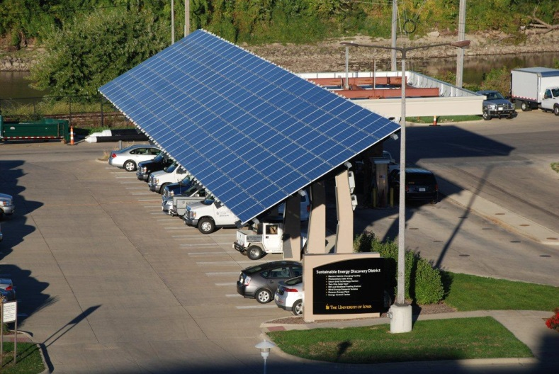
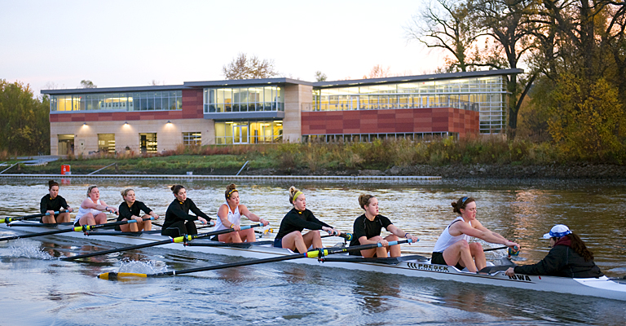
Solar, Wind & Geothermal

Slide 11
Plant Operations

Slide 12
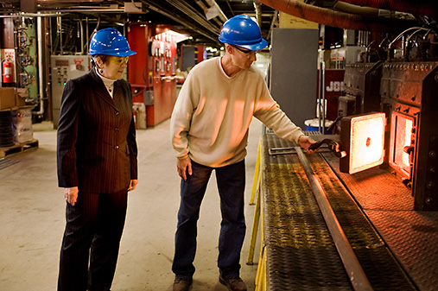
Solid Fuel Boiler

Slide 13
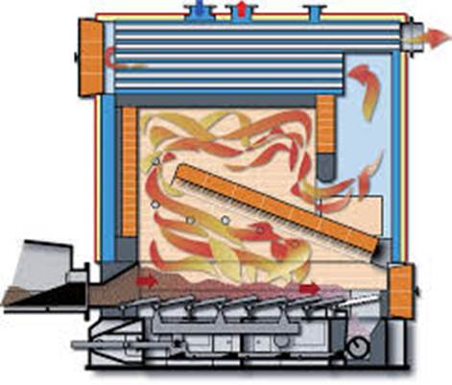
Boiler #10 – Stoker Boiler

Slide 14
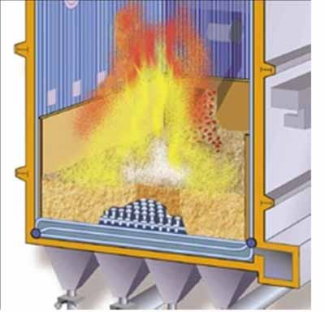
Boiler #11 – Fluidized Bed

Slide 15
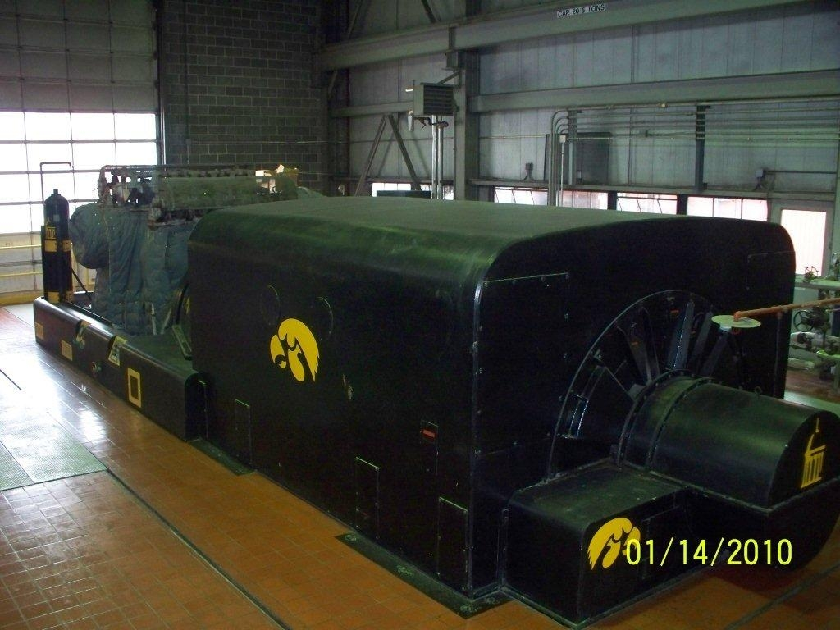
Turbine Generator

Slide 16
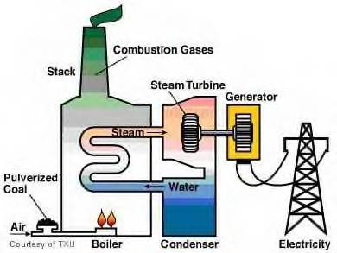
Typical Utility System

Slide 17
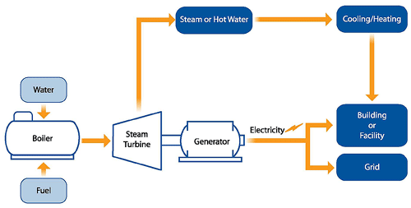
Cogeneration System

Slide 18
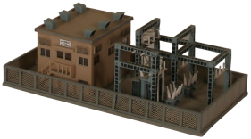
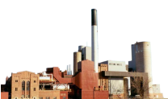
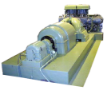
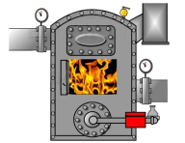
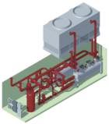
University of Iowa Main Campus Utilities
Substation U
161 kV
Substation L
69 kV
West Campus
East Campus
Power Distribution West
Across Campus Tie
Power Distribution East
Water Treatment Plant
Potable Water Distribution
West
Potable Water Distribution
East
Natural Gas Engine Electric Generators
Main Power Plant
Steam Turbine Electric Generators
Natural Gas Boilers
Solid Fuel Boilers
Natural Gas Boilers
7
10
11
WCB 1
WCB 2
8
Steam Distribution West
Steam Distribution East
West Chiller Plant
Northwest Plant
North Chiller Plant
Steam Chillers (3)
Steam Chiller (1)
Steam Chillers (3)
UIHC
Natural Gas Boiler
Electric Chillers (8)
Electric Chillers (1)
Chilled Water Distribution
West
Chilled Water Distribution East
Legend: Electrical Chilled Water
Steam Potable Water

Slide 19
Utilities & Energy Management

Slide 20
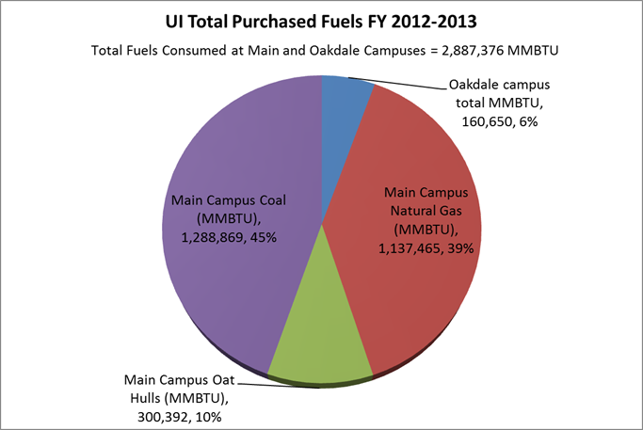
Purchased Fuels

Slide 21
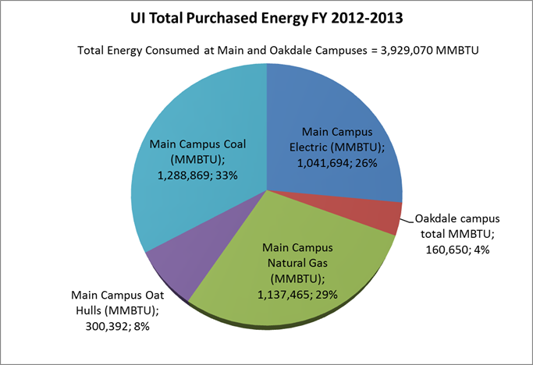
Purchased Energy

Slide 22
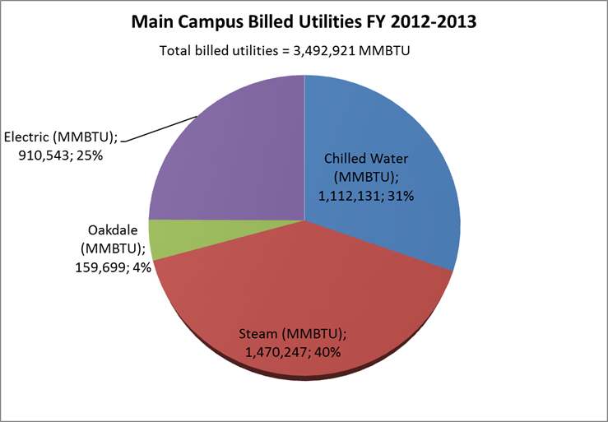
Distribution by Energy Content

Slide 23
Utilities Enterprise Budget

Slide 24
Mid American Incentives

Slide 25
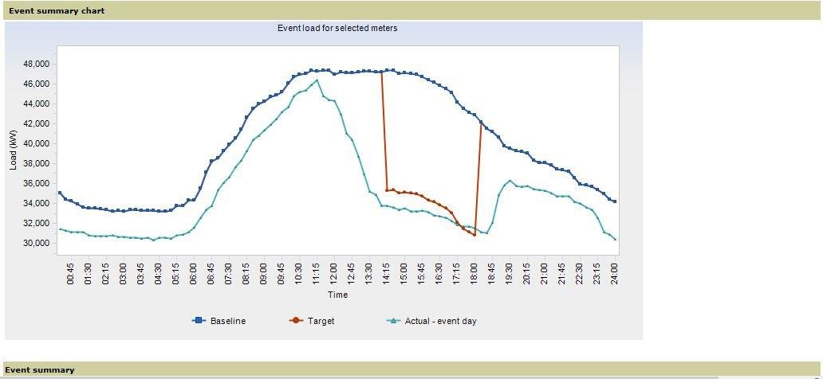
Curtailment Response

Slide 27
Energy Use By Buildings FY2013
Bldg Name | EL MMBtu | ST (MMBTU) | CW (MMBtu) | TOTAL (MMBtu) | % of Total | Cumulative Total %
POMERANTZ FAMILY PAVILION | 73,525 | 89,233 | 86,060 | 248,818 | 9.45% | 9.45%
COLLOTON PAVILION | 80,539 | 41,358 | 117,127 | 239,024 | 9.08% | 18.54%
GENERAL HOSPITAL | 30,945 | 98,903 | 47,094 | 176,942 | 6.72% | 25.26%
BOWEN SCIENCE BUILDING | 35,359 | 91,797 | 42,950 | 170,106 | 6.46% | 31.72%
CARVER PAVILION | 49,287 | 39,504 | 59,853 | 148,643 | 5.65% | 37.37%
PAPPAJOHN PAVILION | 38,174 | 43,515 | 44,319 | 126,008 | 4.79% | 42.16%
MEDICAL EDUCATION RESEARCH FACILITY | 22,621 | 77,427 | 24,298 | 124,346 | 4.72% | 46.89%
MEDICAL LABORATORIES | 21,829 | 43,997 | 31,406 | 97,232 | 3.69% | 50.58%
50+% of Energy Use in 8 Buildings

Slide 28
Bldg Name | EL MMBtu | ST (MMBTU) | CW (MMBtu) | TOTAL (MMBtu) | % of Total | Cumulative Total %
POMERANTZ FAMILY PAVILION | 73,525 | 89,233 | 86,060 | 248,818 | 9.45% | 9.45%
COLLOTON PAVILION | 80,539 | 41,358 | 117,127 | 239,024 | 9.08% | 18.54%
GENERAL HOSPITAL | 30,945 | 98,903 | 47,094 | 176,942 | 6.72% | 25.26%
BOWEN SCIENCE BUILDING | 35,359 | 91,797 | 42,950 | 170,106 | 6.46% | 31.72%
CARVER PAVILION | 49,287 | 39,504 | 59,853 | 148,643 | 5.65% | 37.37%
PAPPAJOHN PAVILION | 38,174 | 43,515 | 44,319 | 126,008 | 4.79% | 42.16%
MEDICAL EDUCATION RESEARCH FACILITY | 22,621 | 77,427 | 24,298 | 124,346 | 4.72% | 46.89%
MEDICAL LABORATORIES | 21,829 | 43,997 | 31,406 | 97,232 | 3.69% | 50.58%
PHARMACY BUILDING | 21,727 | 48,137 | 23,856 | 93,720 | 3.56% | 54.14%
DENTAL SCIENCE BUILDING | 15,387 | 52,671 | 22,710 | 90,767 | 3.45% | 57.59%
CHEMISTRY BUILDING | 27,611 | 28,992 | 31,326 | 87,929 | 3.34% | 60.93%
BOYD TOWER | 23,333 | 25,276 | 13,627 | 62,237 | 2.36% | 63.30%
LIBRARY (MAIN) | 17,943 | 20,685 | 23,553 | 62,181 | 2.36% | 65.66%
CARVER BIOMEDICAL RESEARCH BUILDING | 17,394 | 22,851 | 20,359 | 60,604 | 2.30% | 67.96%
SOUTH WING | 17,629 | 23,797 | 16,687 | 58,113 | 2.21% | 70.17%
IOWA ADVANCED TECHNOLOGY LABORATORIES | 13,557 | 19,320 | 17,227 | 50,104 | 1.90% | 72.07%
IOWA MEMORIAL UNION | 10,873 | 19,551 | 13,160 | 43,584 | 1.66% | 73.73%
SEAMANS CENTER | 14,203 | 16,251 | 10,630 | 41,084 | 1.56% | 75.29%
BIOLOGY BUILDING | 13,576 | 14,166 | 9,489 | 37,231 | 1.41% | 76.71%
ECKSTEIN MEDICAL RESEARCH BUILDING | 17,449 | 17,368 | 364 | 35,181 | 1.34% | 78.04%
LINDQUIST CENTER | 12,798 | 8,198 | 12,891 | 33,886 | 1.29% | 79.33%
UNIVERSITY CAPITOL CENTRE | 14,700 | 7,520 | 9,453 | 31,673 | 1.20% | 80.53%
80+% of Energy Use in 22 Buildings

Slide 30
Top Energy Intensive Buildings
Bldg Name | TOTAL (MMBtu) | Total EUI Btu/ksf
PHARMACY BUILDING | 93,720 | 655.51
MEDICAL EDUCATION RESEARCH FACILITY | 124,346 | 537.96
BOWEN SCIENCE BUILDING | 170,106 | 453.55
CARVER BIOMEDICAL RESEARCH BUILDING | 60,604 | 444.17
MEDICAL LABORATORIES | 97,232 | 426.13
DENTAL SCIENCE BUILDING | 90,767 | 403.49
IOWA ADVANCED TECHNOLOGY LABORATORIES | 50,104 | 391.64
BIOLOGY BUILDING EAST | 22,397 | 359.23

Slide 31
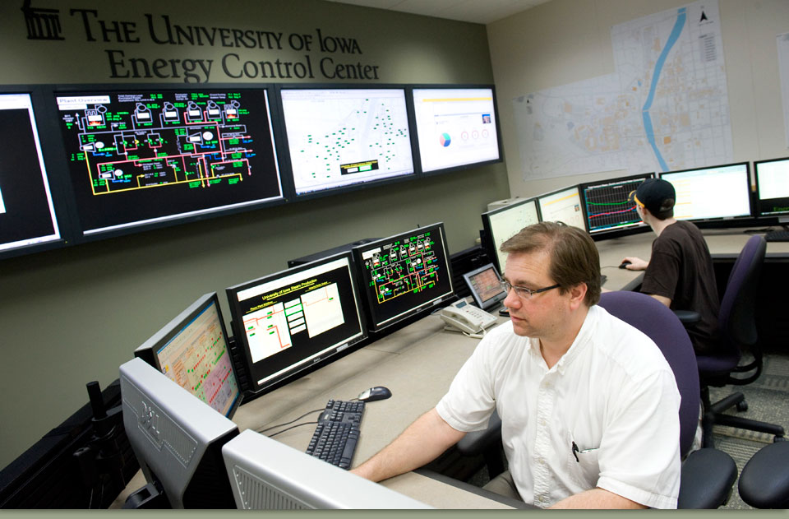
Energy Control Center

